Slide 1

Introduction to Software Business Product management
Week 1 Day 3
Led by: Emily Crose
for
Oakland University

Slide 2

Day 2 recap

Slide 3

Questions From Day 2?

Slide 4

Securing & Encrypting data

Slide 5

Cleartext vs. ciphertext
Notes:
To better understand how encryption works, we need to first understand the two basic states information can be in when they’re encrypted. When we have information we can read whenever we want, we can give to someone else and let them read it, we have text we can clearly read. Cleartext. Now, once we encrypt our information, we’ll have something completely different. We’ll have something totally unreadable by humans. We’ll have a cipher, or ciphertext.

Slide 6
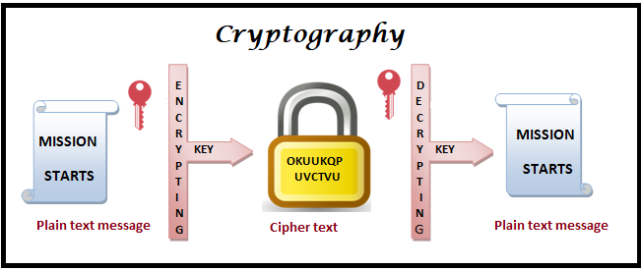

Slide 7

Hashing
Notes:
Last week, we talked about “hashing” Does anyone remember the context of what we discussed hashing in?
We talked about hashing in the context of CRCs on information sent over a network.

Slide 8
Value of hashing
Layer of validation of data
Secures both ends of transmission
Anyone can validate!
Protects original secret
irreversible

Slide 9
Popular Hashing algorithms
MD5
SHA-1 (compromised)
SHA-2
SHA-3
LM/NTLM hash (for Windows passwords)
Notes:
9ece086e9bac491fac5c1d1046ca11d737b92a2b2ebd93f005d7b710110c0a678288166e7fbe796883a4f2e9b3ca9f484f521d0ce464345cc1aec96779149c14

Slide 10

Let’s try some hash!
https://gchq.github.io/CyberChef/

Slide 11

What is encryption?

Slide 12
Encryption history

Slide 13

Hand ciphers
Substitution (or “Caesar”) cipher – (850 CE)
Code book cipher – (1500s)
Vigenère cipher – (1553)
First to use an encryption key
Jefferson cipher – (1795)
Playfair cipher – (1854)

Slide 14
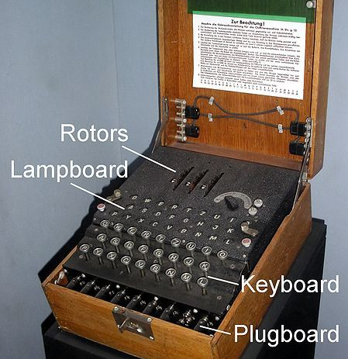
Wartime cryptography

Slide 15
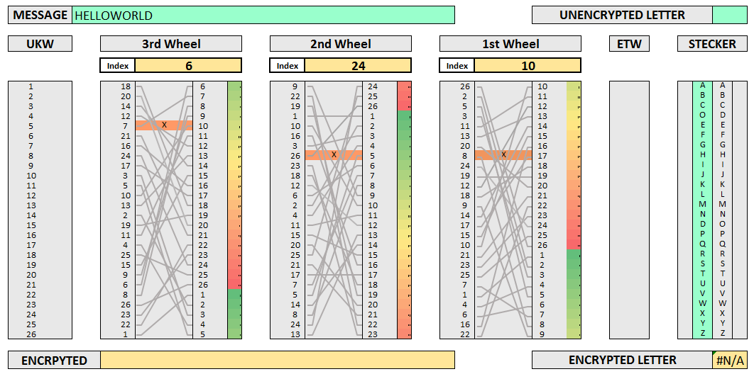

Slide 16

10 minute break

Slide 17
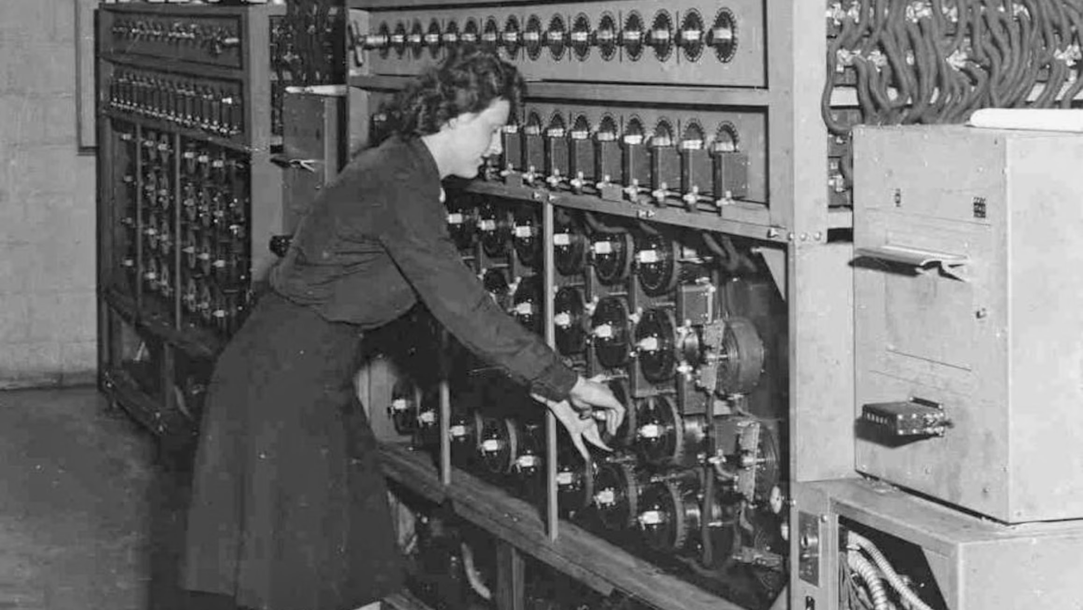
Password cracking
Notes:
Password reuse. Implementation failure. Brute force attacks.

Slide 18
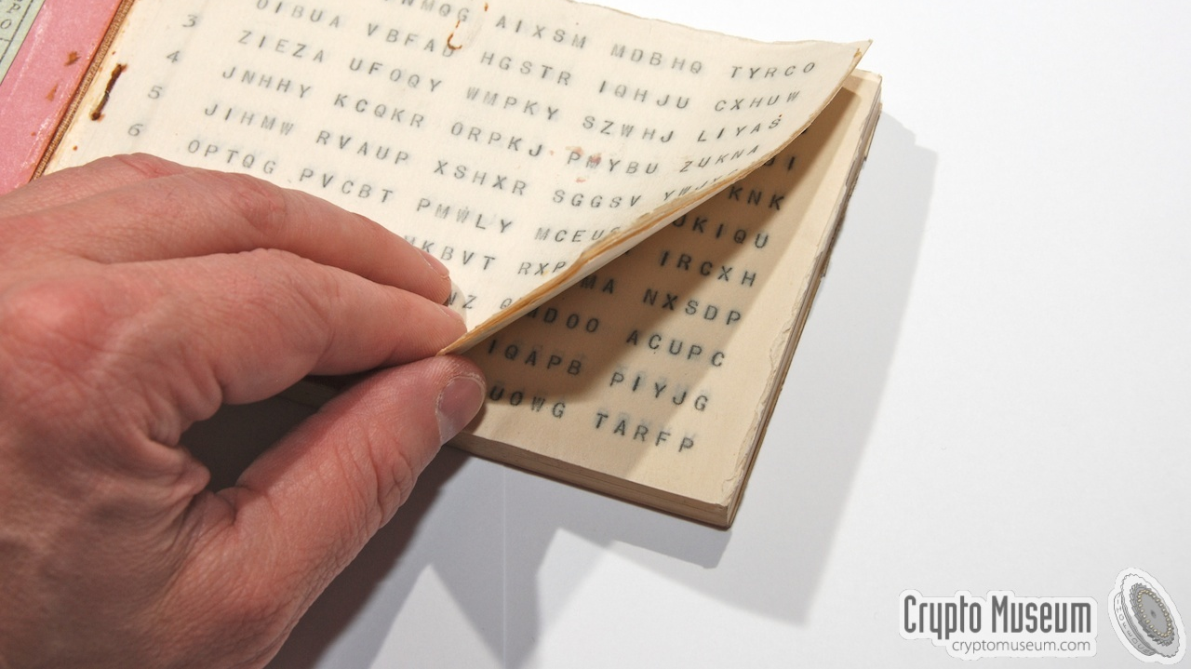
One-time pads

Slide 19

Venona Project
Notes:
Message interception and password cracking

Slide 20

Why do we encrypt?

Slide 21

What do we encrypt?

Slide 22
How do we encrypt today?

Slide 23
Popular Modern cryptography algorithms
Rivest-Shamir-Adleman (RSA) – (1977)
Based on prime number factorization
Advanced Encryption Standard (AES) 256
Block cipher

Slide 24
Keyspace/keylength/keysize
AES
Supports key sizes of 128, 192, 256
Key sizes improve the strength of cryptographic protection
2048 & 4096 key sizes
Large keys
Hard to brute force

Slide 25
Cryptographic standards
https://csrc.nist.gov/Projects/cryptographic-standards-and-guidelines

Slide 26
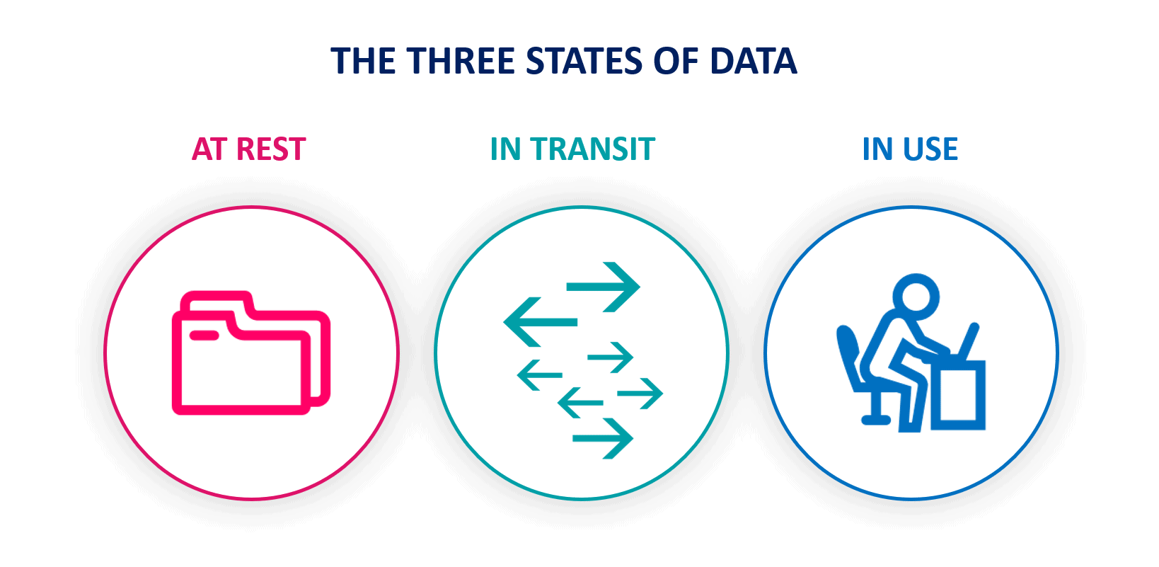
States Of Data

Slide 27
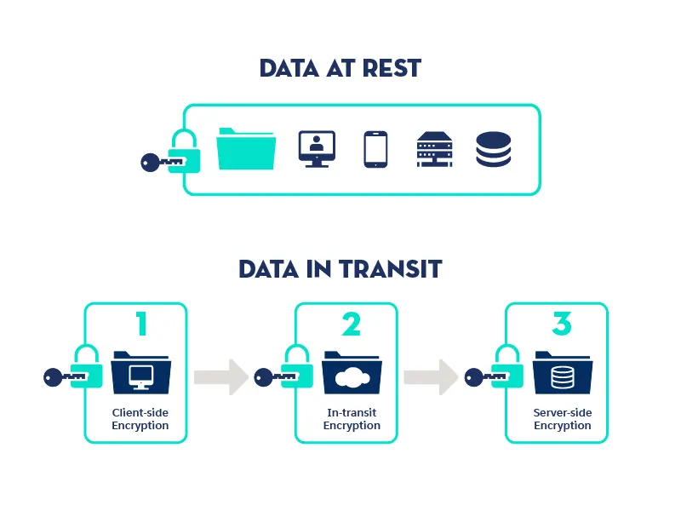
data security

Slide 28
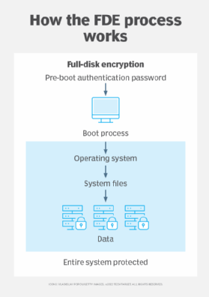
Full disk encryption

Slide 29

Symmetric Key Encryption

Slide 30
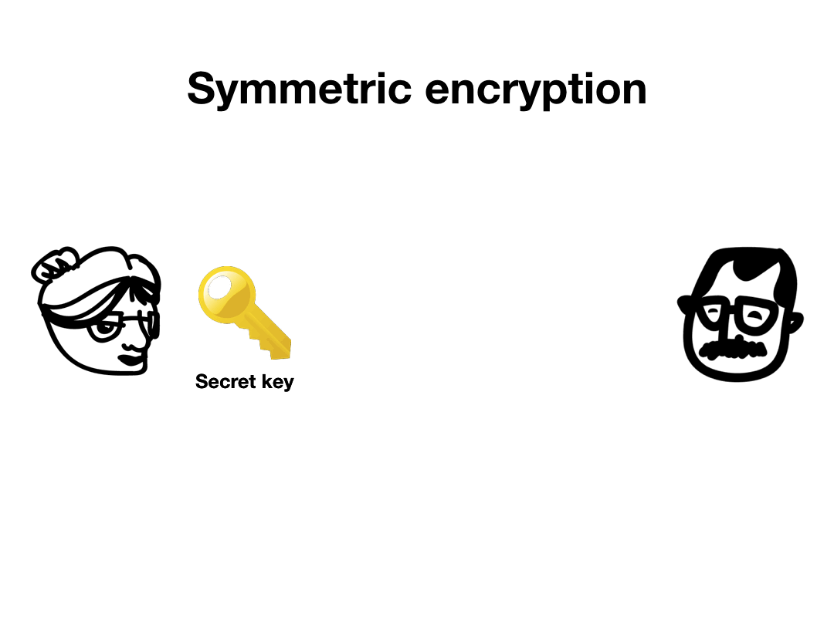

Slide 31

Asymmetric key encryption

Slide 32
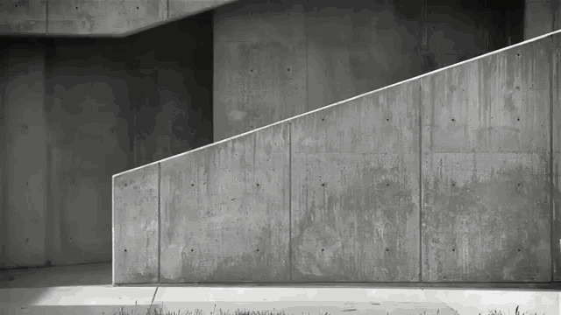
Secure Key Exchange?

Slide 33
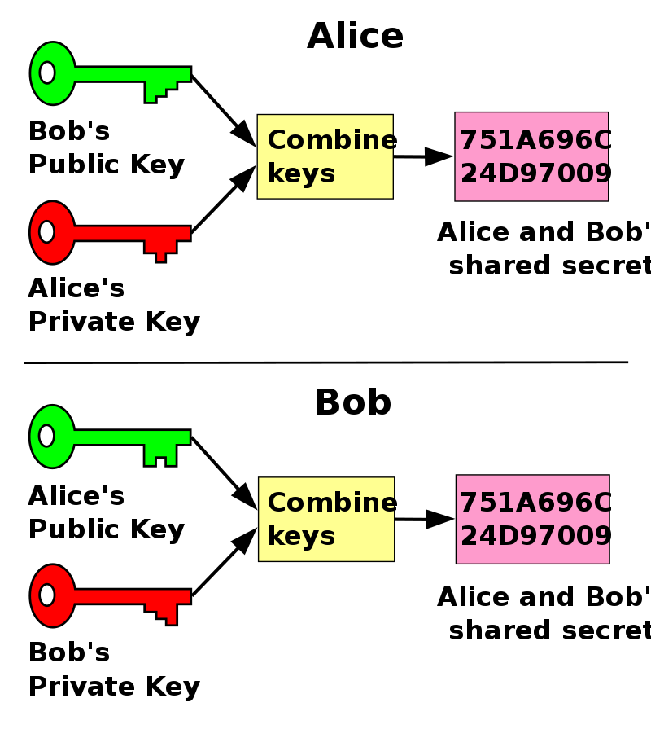
Public key cryptography
Notes:
This is an example of a Diffie-Hellman-Merkle key exchange

Slide 34
10 minute break

Slide 35
Securing network connections in practice

Slide 36
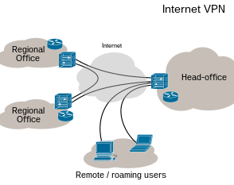
Virtual private networks

Slide 37
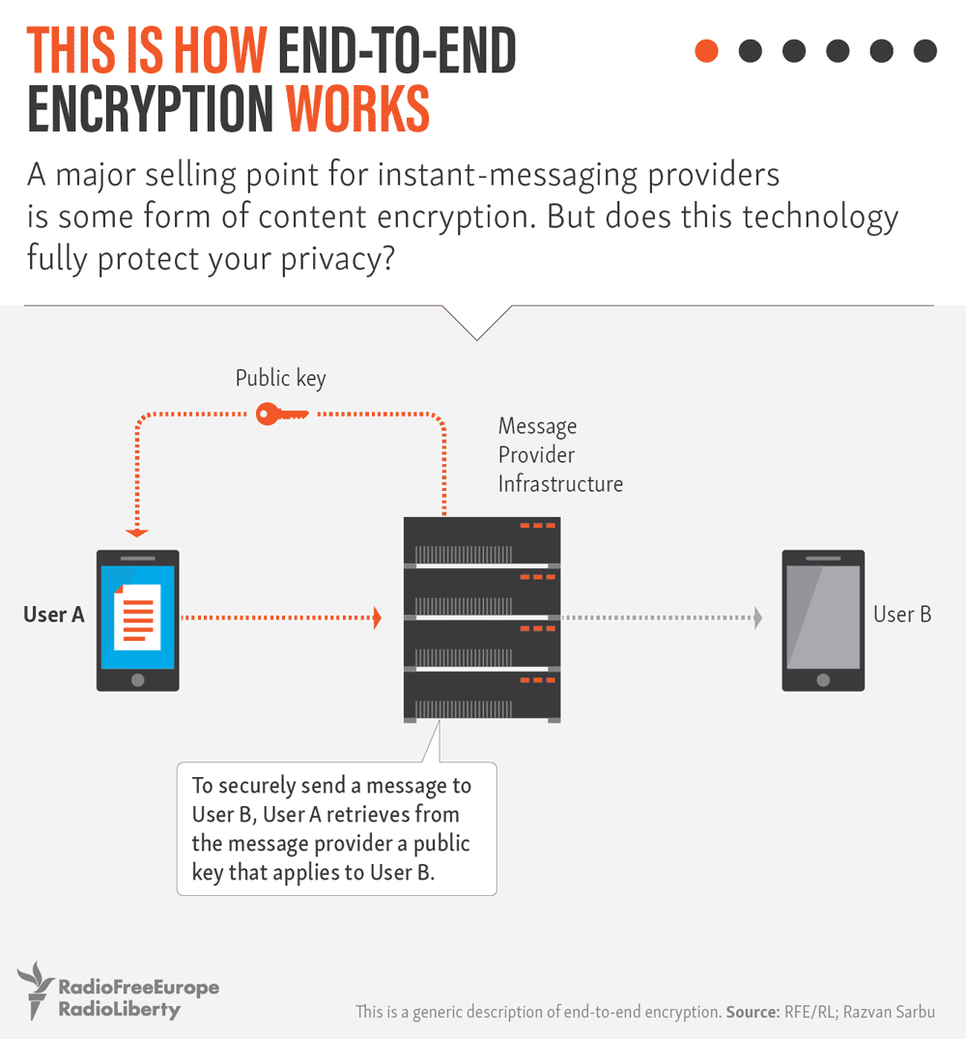

Slide 38
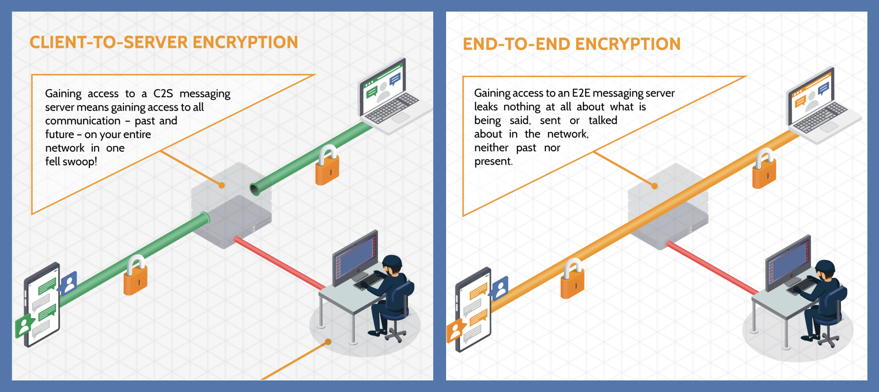
Notes:
The alternative to end-to-end encryption is client-to-server encryption.

Slide 39

Why do we care about trust?

Slide 40
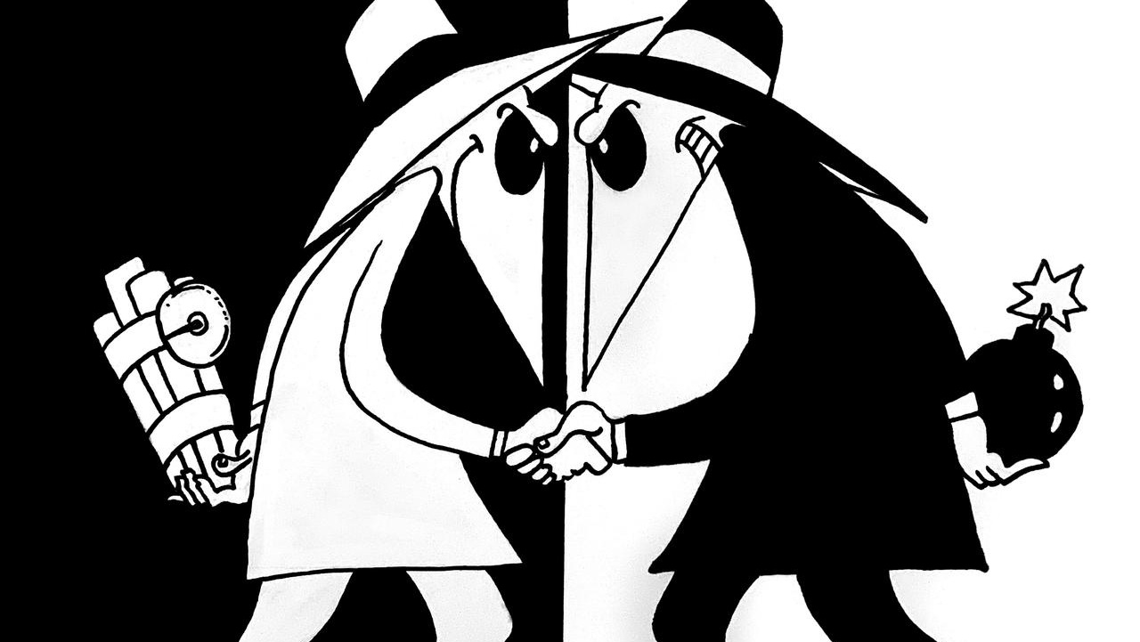

Slide 41

What is a security certificate?

Slide 42
What does a security certificate do?
Provides trust
Allows a secure connection
Encrypts data
HTTPS

Slide 43
Certificate authorities
X.509 certificate
Provides Transport Layer security
Free!
Trusted?

Slide 44
How do we know who we can and can’t trust?

Slide 45

Audit your favorite website!
https://www.sslshopper.com/ssl-checker.html

Slide 46

Threats to poor encryption
Cleartext passwords
Password cracking
Man-In-The-Middle (MITM) attack
Rainbow Tables
Hash collisions

Slide 47
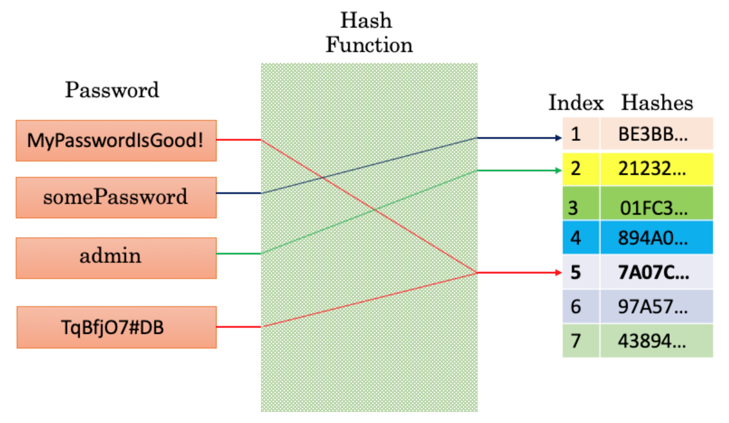
Hash Collisions
Notes:
Here we have a representation of hashing passwords using MD5. MD5 hashes have a relatively high potential for collision, so we don’t use it much anymore due to this. In this image, we can see that we have a collision between the first password and the last one.

Slide 48
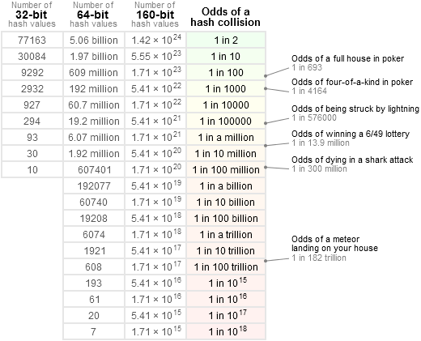
Collision probabilities

Slide 49
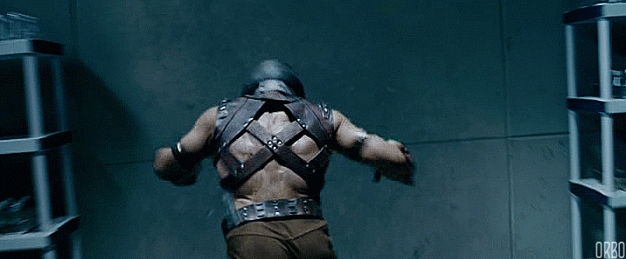
Brute Forcing

Slide 50
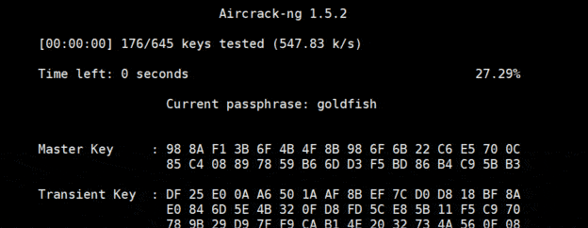
Real-life password cracking

Slide 51
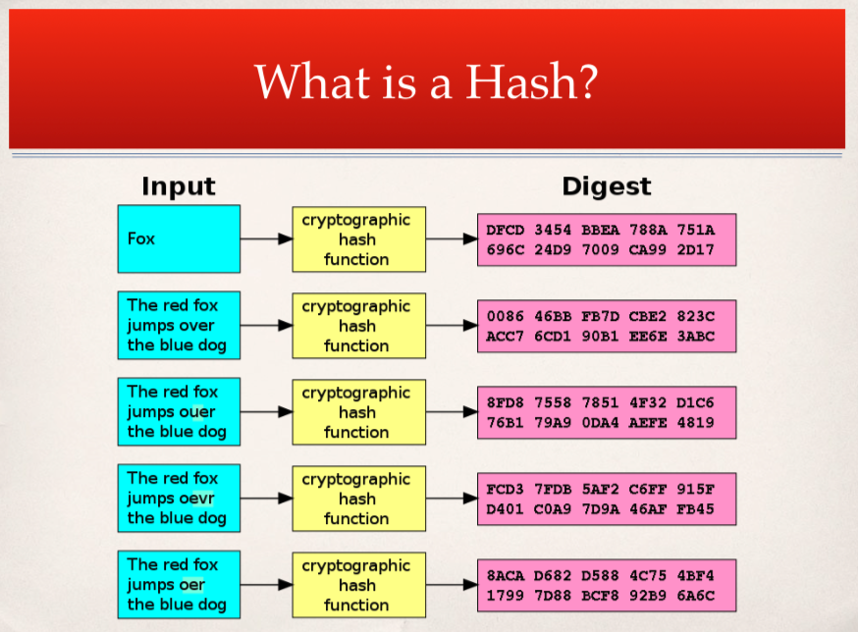
Rainbow Tables
Notes:
Let’s revisit hashing – here we can see a series of inputs hashed and presented in a digest.

Slide 52
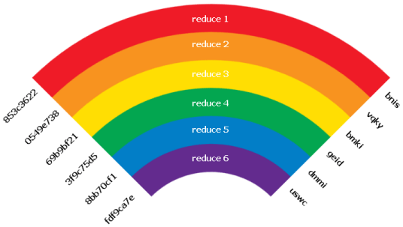
Rainbow Tables Cont’
Notes:
To make a rainbow table, you need a hash, and a “reduction” function. We just discussed hashing, so what’s a reduction? We’re not reversing hashes, but we are taking a hash and creating a usable password with them. Each time we reduce an input hash, we will generate a new potential hash that we can use to authenticate with.

Slide 53
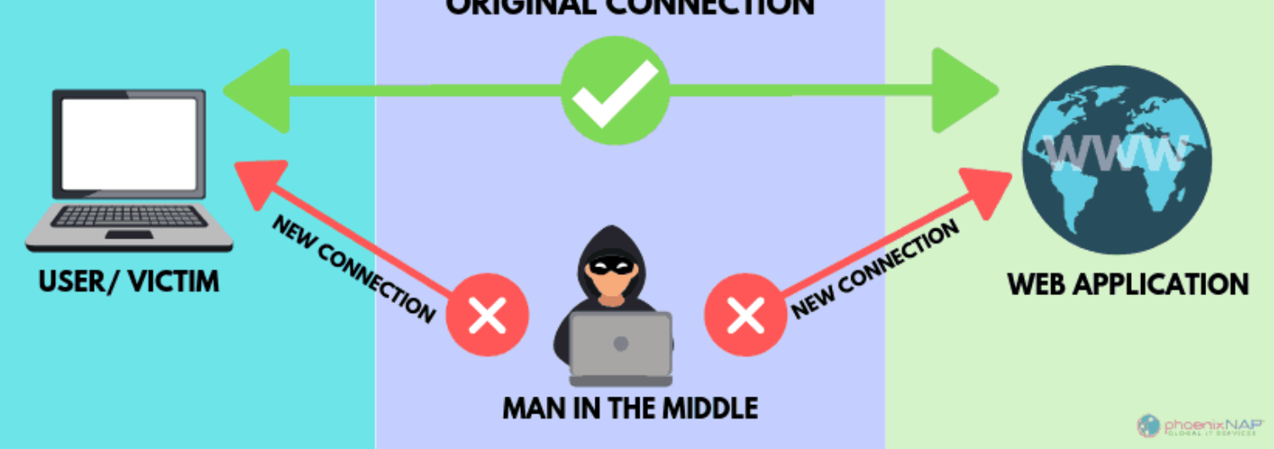
Man-In-The-Middle
Notes:
MITM, password sniffing, collecting cleartext information

Slide 54
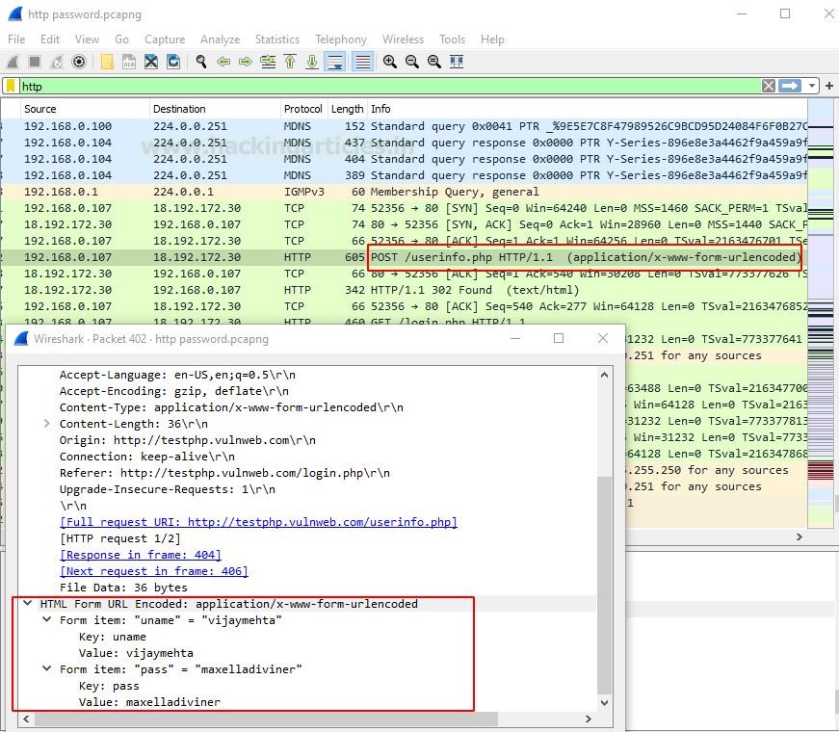

Slide 55
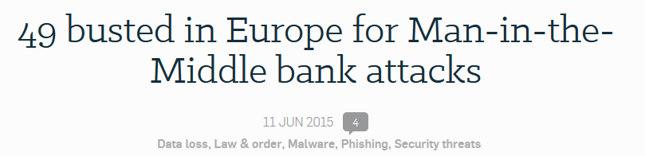
Real-World MITM attack
Notes:
49 attackers were arrested for collecting improperly protected network traffic after a breach on multiple companies. They were looking for financial transaction information, which they found and then used to steal 6 Million Euros or $6.8 Million.

Slide 56

Review Day 3

Slide 57

Questions?

Slide 58

Preview day 4

